Slide 1

Docker intro

Slide 2
What is docker?
Container technology
Uses dockerfile to build docker images to run in a docker container

Slide 3
Why use docker?
Faster
Easier to collaborate
Less frustration

Slide 4
Must know commands
docker images – shows all images in your local docker registry
docker ps – shows all running containers on your machine
docker search <image_name> - shows available images on docker hub with specified image name
docker pull <image_name>:<tag> - pull image from docker hub with specified tag, if no tag provided it will pull ”latest”
docker run <options> <image_name>:<tag> - runs container with specified options
docker stop (<container_id> || <container_name>) – stops container
docker rm (<container_id> || <container_name>) – removes stopped container, use “-f” to forcefully remove running container
docker rmi (<image_id> || <repository>:<tag>) – if no tag specified, will remove ”latest”
docker --help - shows all available commands

Slide 5
Options for when running container
-p – specifies port
-d – runs container in background
--name – specifies name for container
-v – mounts volume

Slide 6
Docker hello-world
docker pull hello-world – pulls latest “hello-world” image from docker hub
docker images – lists available images on local repository
docker inspect hello-world – shows a list of data for the image
docker run hello-world – runs hello-world image
docker ps, docker ps –a – shows containers, “-a” option shows also stopped containers
docker logs <container-id> - shows container logs
docker rm <container-id> - removes container
docker rmi <image> - removes images from local repository

Slide 7
Docker nginx
docker pull nginx
docker inspect nginx (finn ExposedPorts under config)
docker run --name nginx-test -d -p 8080:80 nginx
docker ps
curl localhost:8080
vim index.html || echo “Hello from IBM” >> index.html
docker exec -it nginx-test bash
cat /usr/share/nginx/html/index.html
docker cp index.html nginx-test:/usr/share/nginx/html/index.html
docker rm -f nginx-test

Slide 8
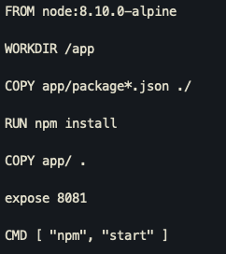
Dockerfile
Dockerfile is a description of that consist of different steps needed to create a docker image.
git clone https://github.com/mast0910/api-bootcamp.git
vim Dockerfile add this ➔
Docker build -t api-bootcamp .

Slide 9
Multiple containers
Create
Create network called ”bootcamp”
Containerize
Spin up nginx, couchdb and api-bootcamp and connect them to the network.
Copy over
Copy over docker-bootcamp-ui.html to nginx
Create
Create “mydb” using ‘curl -X POST -i localhost:5984/mydb’
Check
In browser navigate to localhost:8081

Slide 10
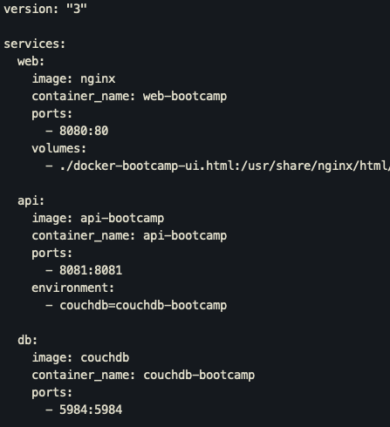
Docker-compose
Docker compose uses yaml file to automate creation of containers
Create a docker-compose.yaml file
Spin up everything using ‘docker-compose up’
Spin everything down using ‘docker-compose down’

Slide 11
That’s it for now boys and girls

